Slide 1






Audio Effect Processor
DSP LAB – EEE 3310

Slide 2




Team Members
Naimur Rahman – 021 221 043
Md. Nayon Khan – 021 221 045
Suvom Karmakar– 021 221 027

Slide 3

Table of Contents
User Interface
Basic & Reverse Basic Effects
Dynamic & Reverse Dynamic Effects
Spectrum &Reverse Spectrum Effects
Time Based Effects
Result and Analysis
Applications & Limitations
Conclusion

Slide 4

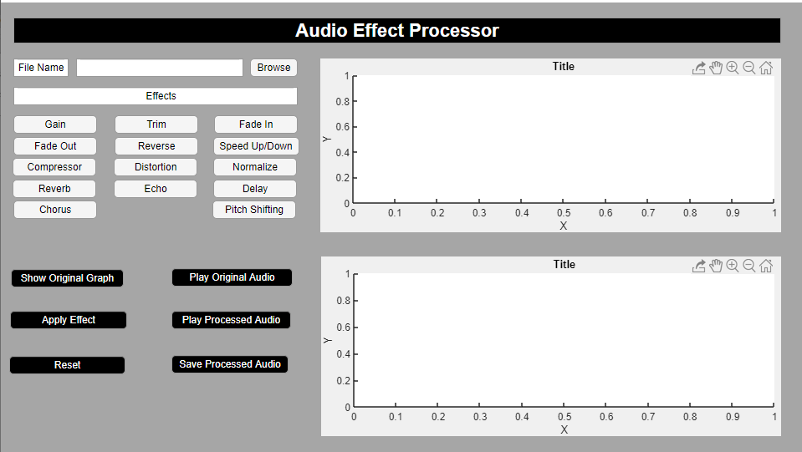
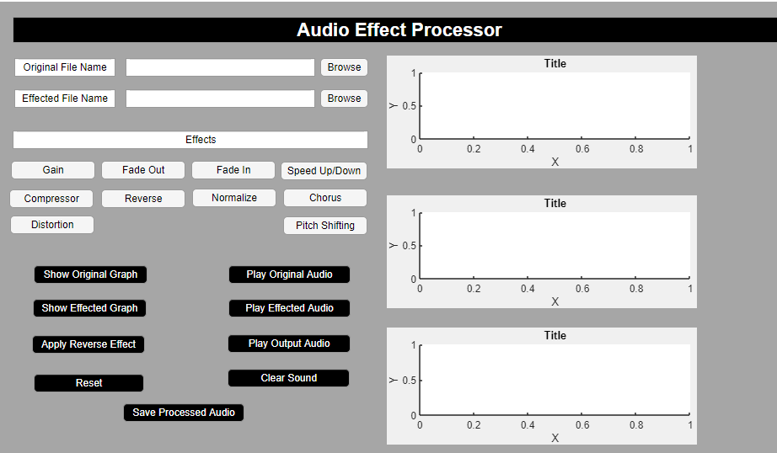
User Interface
Two separate app user friendly interface
User Interface for All Effects
User Interface for Reverse Effects
Buttons
Browse button for file choose
All available effect buttons
Button to apply effect
Play different audios
Sound clear button
Reset button
Save button

Slide 5
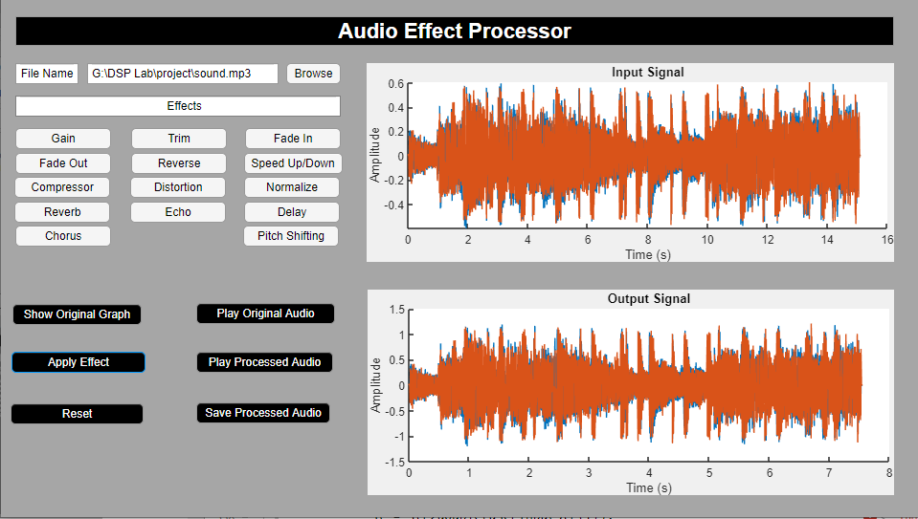
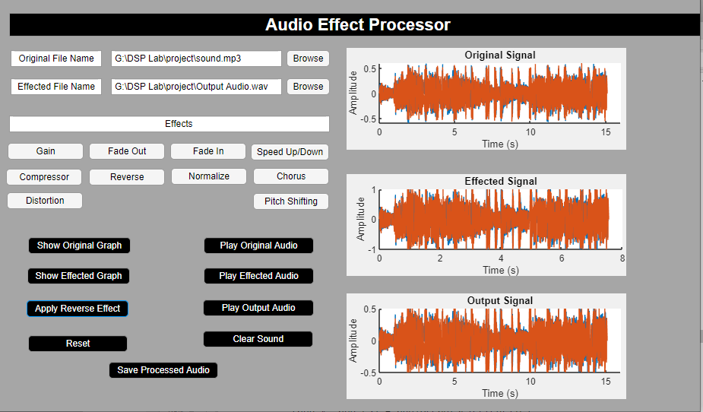
User Interface Features
User can choose any file by browsing
Can see both original and effected graph
Can check if wanted to that reverse graph matched with original
Can save the audio
Can apply multiple effect over one audio
Example of Graphs

Slide 6
Basic Effects
Gain
Trim
Fade in
Fade out
Reverse
Speed up/down

Slide 7
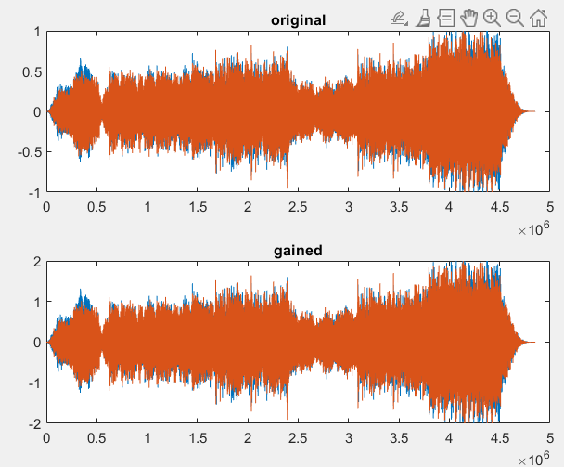
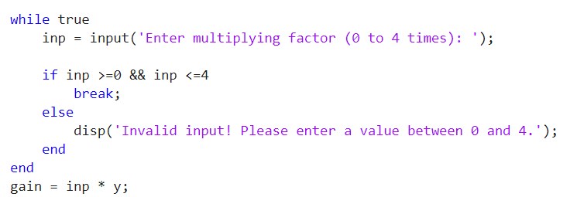
Gain
Amplify 2x
Multiply Signal

Slide 8
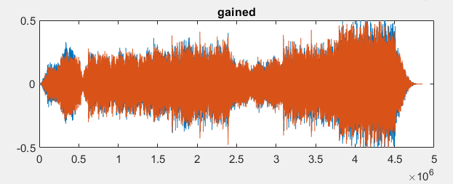
Reverse Gain
Multiply Signal factor< 1
Amplify 0.5x

Slide 9
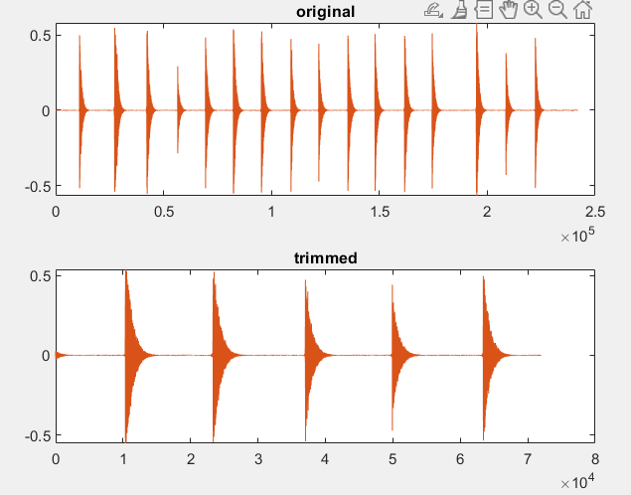
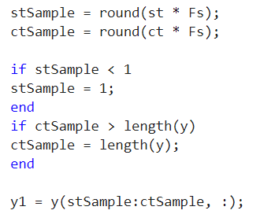
Trim
St = 3s , Ct= 6s
Cutting signal

Slide 10
Reverse Trim
Not possible

Slide 11
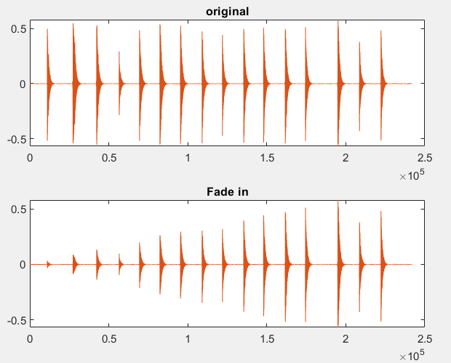
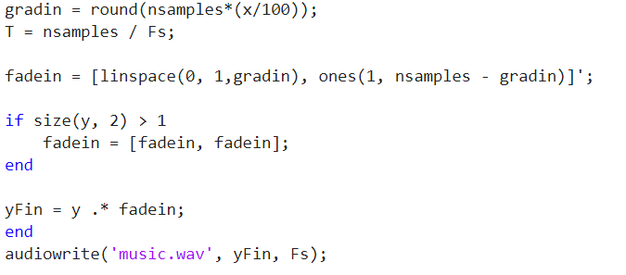
Fade in
Fade in 70%
Linearly increase over time

Slide 12
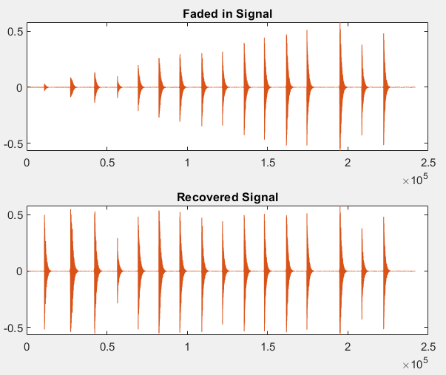
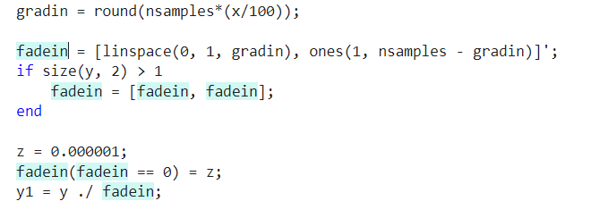
Reverse Fade in
Fade in 70%
Recover the original

Slide 13
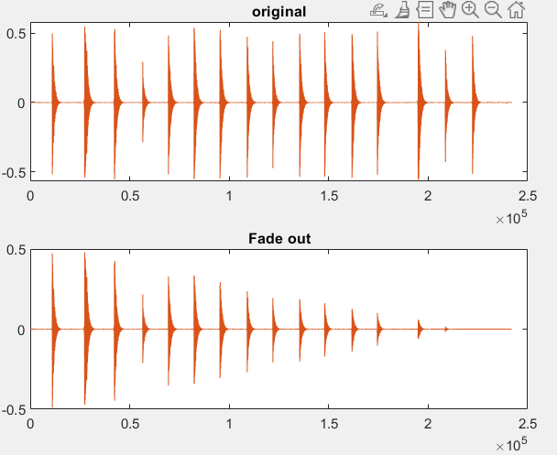
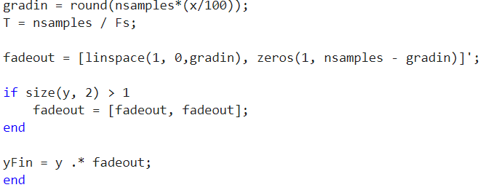
Fade out
Fade out 90%
Linearly decrease over time

Slide 14
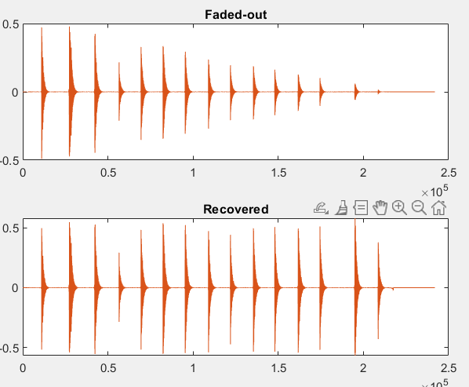
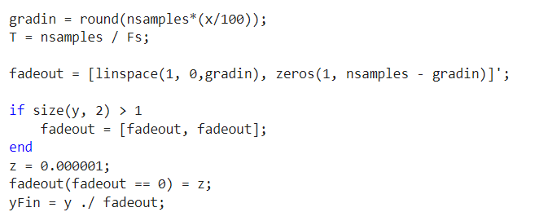
Reverse Fade out
Fade out 90%
Recover Original

Slide 15
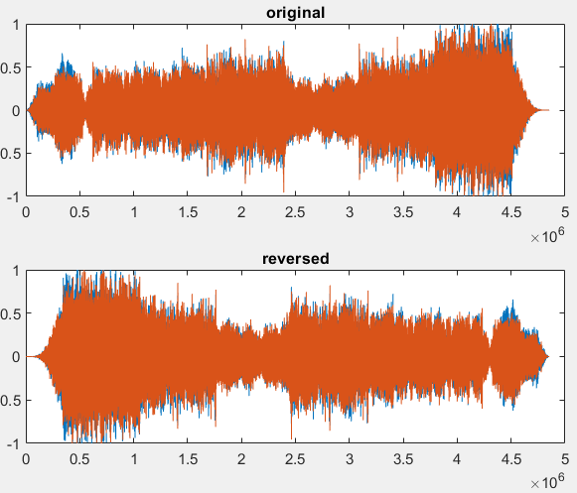
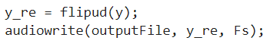
Reverse
Reverse the signal

Slide 16
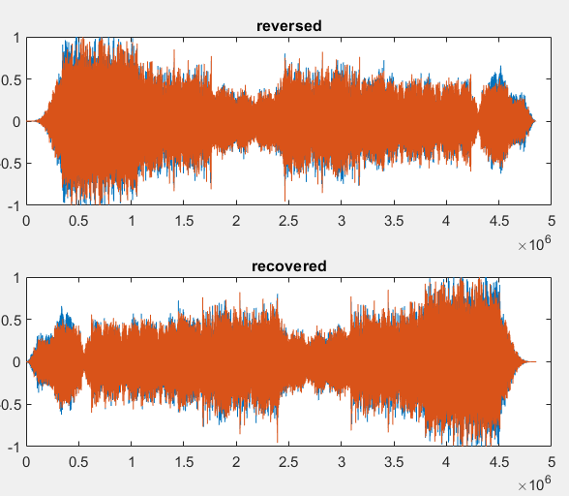
Reverse Flip
Reverse the signal again to recover original

Slide 17
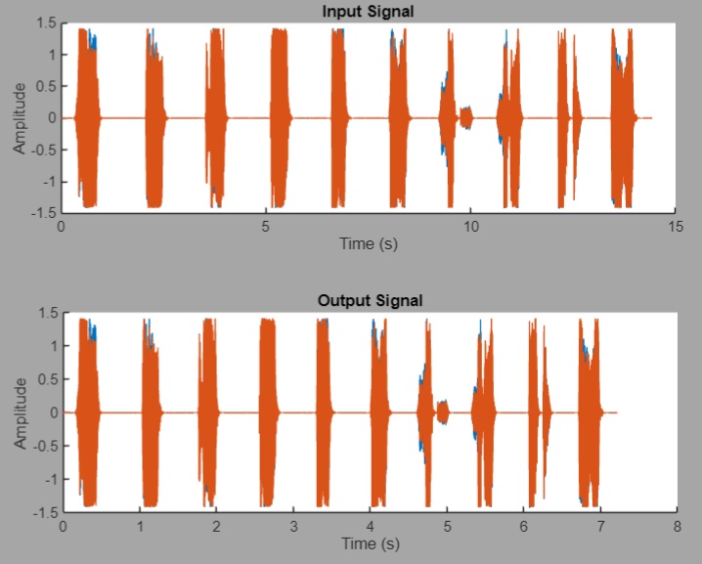
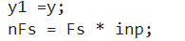
Speed Up
Multiply 2x Fs
Multiplying Sample Rate

Slide 18
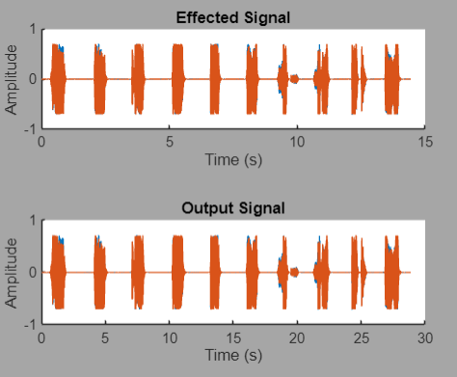
Slows Down
Multiply 0.5x Fs
Divide Sample Rate

Slide 19
Dynamic Effects
Compressor
Normalize
Distortion

Slide 20
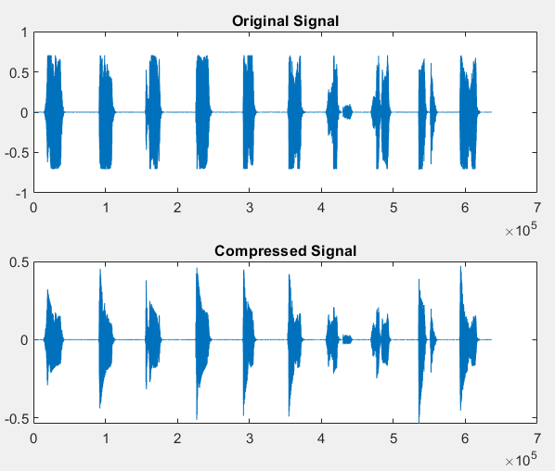
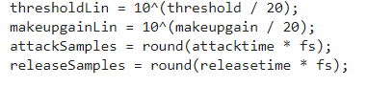
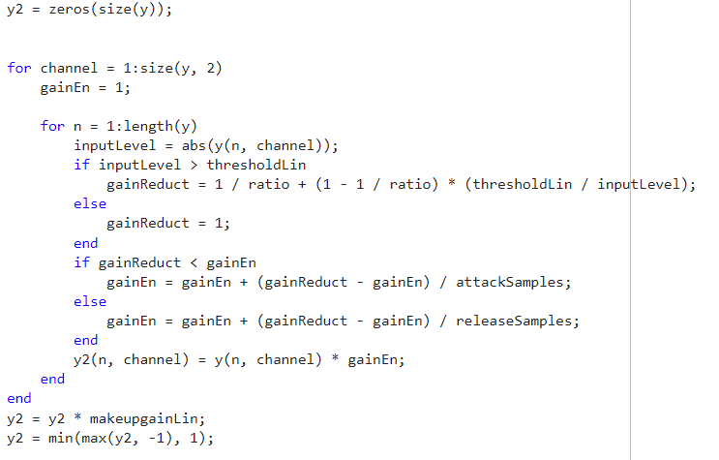
Compressor
Threshold= -85dB,Ratio= 5,
Release time= 0.01s, Attack time = 0.1s,
Makeup gain = 1;
Reduces difference between peak and minimum amplitude

Slide 21
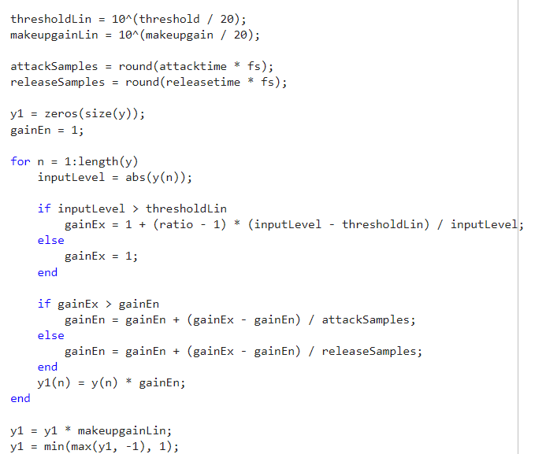
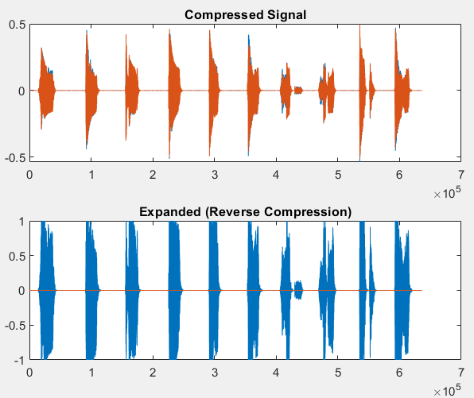
Reverse Compressor
Threshold= -85dB,Ratio= 5,
Release time= 0.01s, Attack time = 0.1s,
Makeup gain = 1dB;
Recover Original

Slide 22
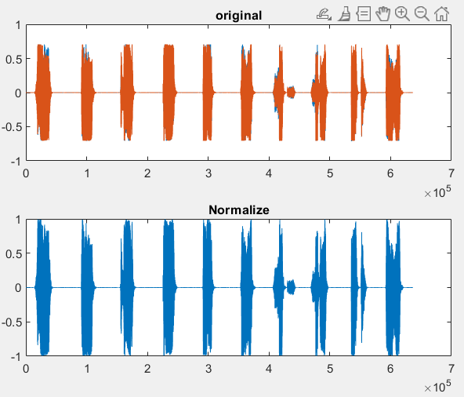
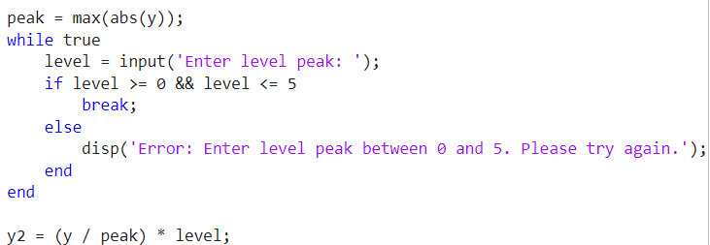
Normalize
Scaling the volume
Level=1;

Slide 23
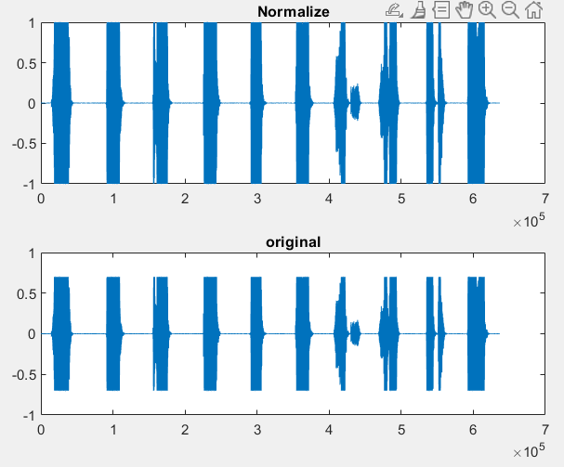
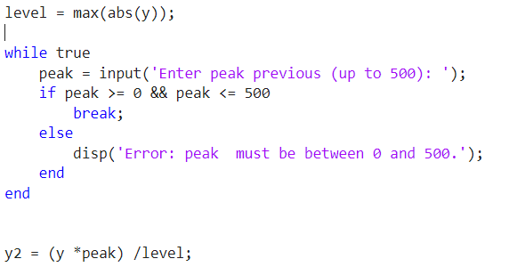
Reverse Normalize
Get back the Original
Previous peak = 0.75;

Slide 24
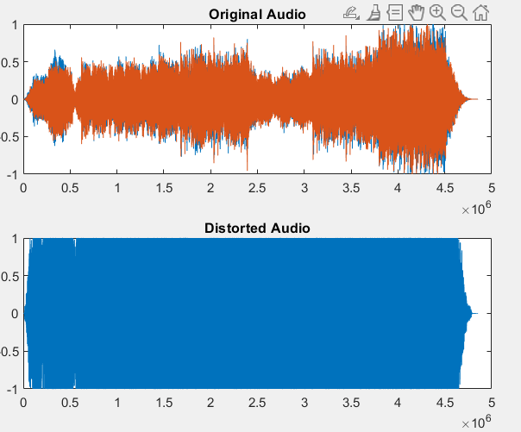
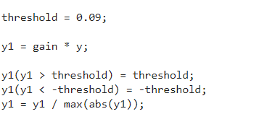
Distortion
Fuzzy & overdriven quality
Gain = 1;

Slide 25
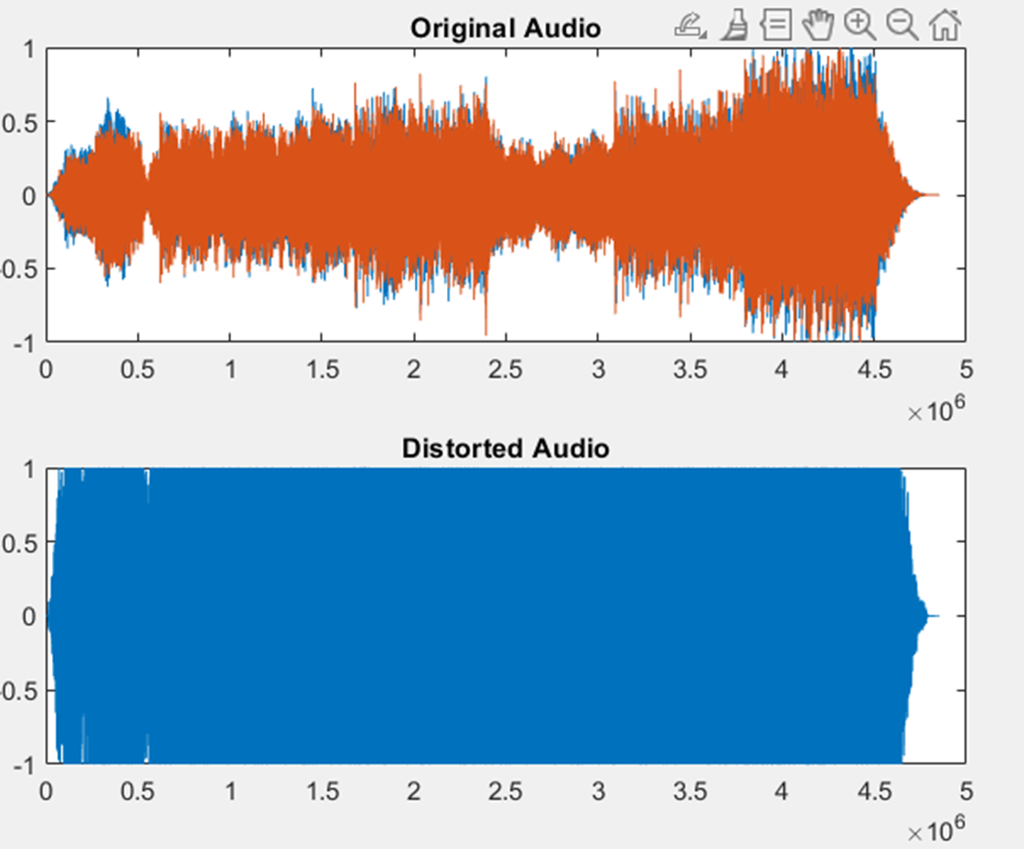
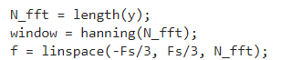
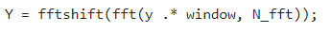
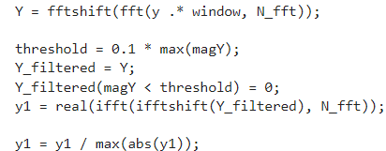
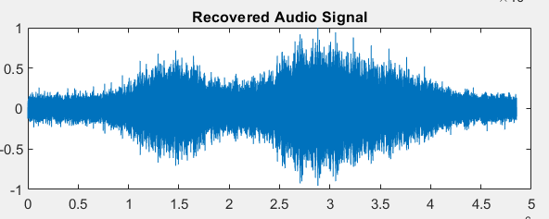
Reverse Distortion
Gain = 1;
Recover the Original
Amplifying factor 1.

Slide 26
Spectrum Effects
Chorus
Equalization
Pitch Shifting

Slide 27
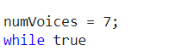
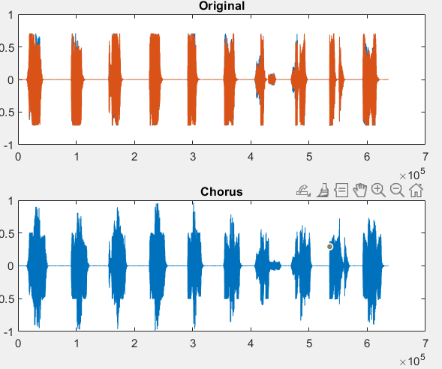
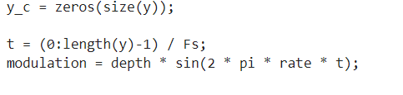
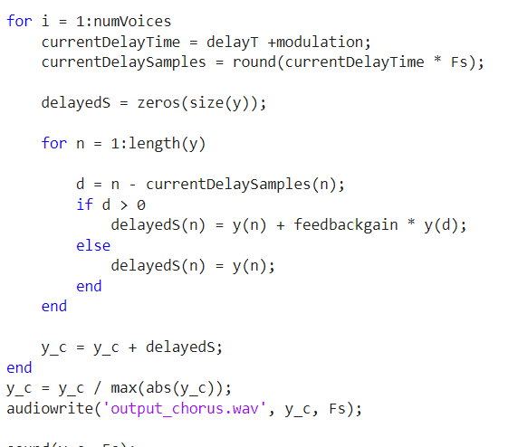
Chorus
Robotic side echo
Delay time = 0.1;Feedback gain=1;

Slide 28
Reverse Chorus
Recover Original
Delay time = 0.1;Feedback gain=1;

Slide 29
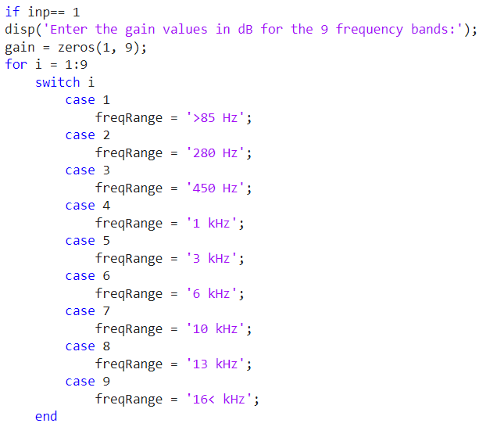
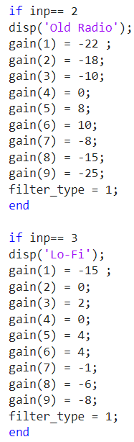
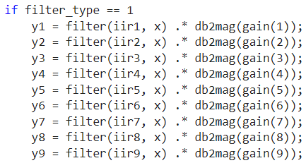
Equalization
Gain changes in diff freq. band creates diff. effects, bass, mids & treble

Slide 30
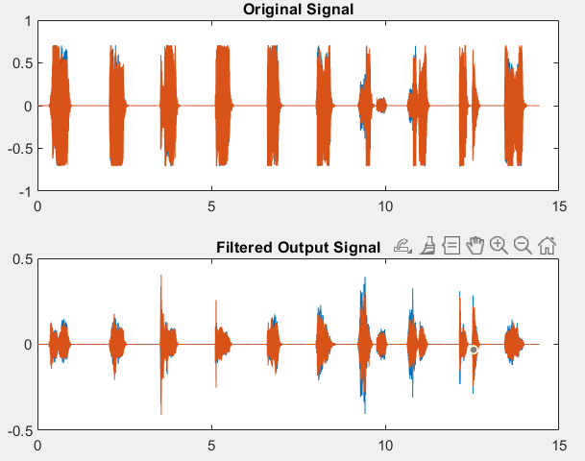
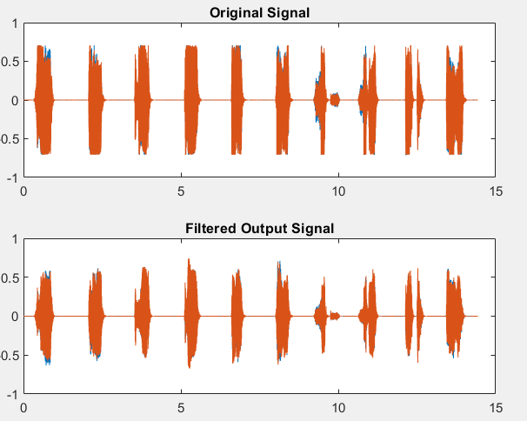
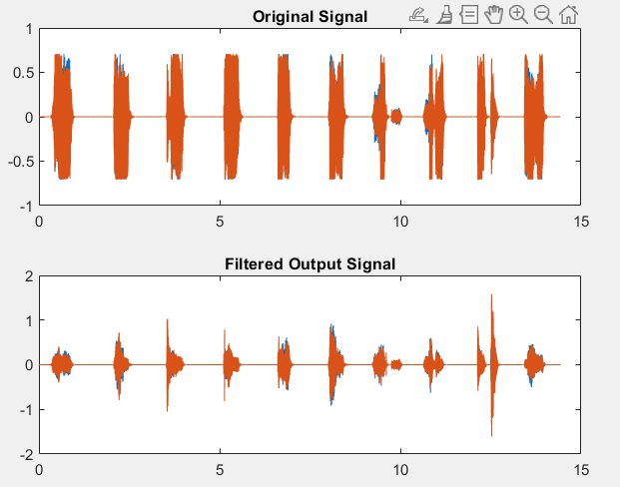
Equalizer Output
Gain for 85 Hz: -20, Gain for 280 Hz: -16, Gain for 450 Hz: -14,
Gain for 1kHz: -8, Gain for 3 kHz: -4, Gain for 6 kHz: 0, Gain for10kHz:
4, Gain for 13kHz: 10, Gain for 16 kHz: 12, filter type IIR
Fixed built in Lo-Fi
Fixed built in Old Radio

Slide 31
Reverse Equalization
Recover original
For reversing the equalizer just need to give gain opposite of previously given input,
in every band to retrieve the original signal.

Slide 32
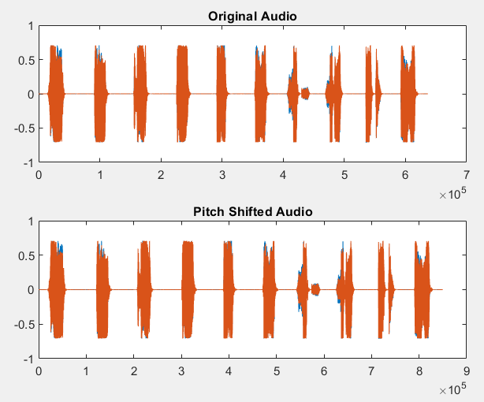

Pitch Shifting
Shift pitch to change in vocals
Semitones= -5;

Slide 33


Reverse Pitch Shifting
Semitones= -5;
Recover the original Vocal

Slide 34
Time Based Effects
Echo
Delay
Reverb

Slide 35


Echo
Repeated decaying sound
Delay time= 0.1;

Slide 36

Delay
Repeated mirroring sound
Delay time= 2;

Slide 37


Reverb
Deep small echoes, calm sound
Wet= 100%;

Slide 38
Reverse Time Based Effect
Recover Original Signal
Techniques of FFT, reverse convolution, and research of MATLAB documentation and online resources.

Slide 39





Result & Analysis
Our system successfully implement 24 effects with counting reverse. We tested it using various audio types, including speech and music, and the
effects were applied effectively. However, 2 effect : Reverse Distortion & Reverse Chorus has Major Errors and failed in Reverse time based effects.

Slide 40





Applications
Real-Time Audio Processing
Audio Editing and Production
Research in Audio Analysis
Audio Applications
Limitations
Irreversibility of Time Based Effect
Limited User Customization

Slide 41
Conclusion

Slide 42
THANK YOU

